Slide 1
Advice
30 Mins
Interim
Slot
30 Mins
Online
Max 20 Mins
Student
Online
5 – 6 Mins
Presentation
3 – 4 Mins
Demo
10 – 12 Mins
Q+A

Slide 2
Sign & Spell VR – Irish Sign Language Alphabet Practice
Karl Negrillo
C22386123
TU858 Computer Science International
Supervisor: Colette Kirwan

Slide 3
Project
VR Application to support learning the Irish Sign Language (ISL) Alphabet through interactive practise.
Uses hand tracking and real-time feedback to help users improve accuracy and engagement compared to traditional learning

Slide 4
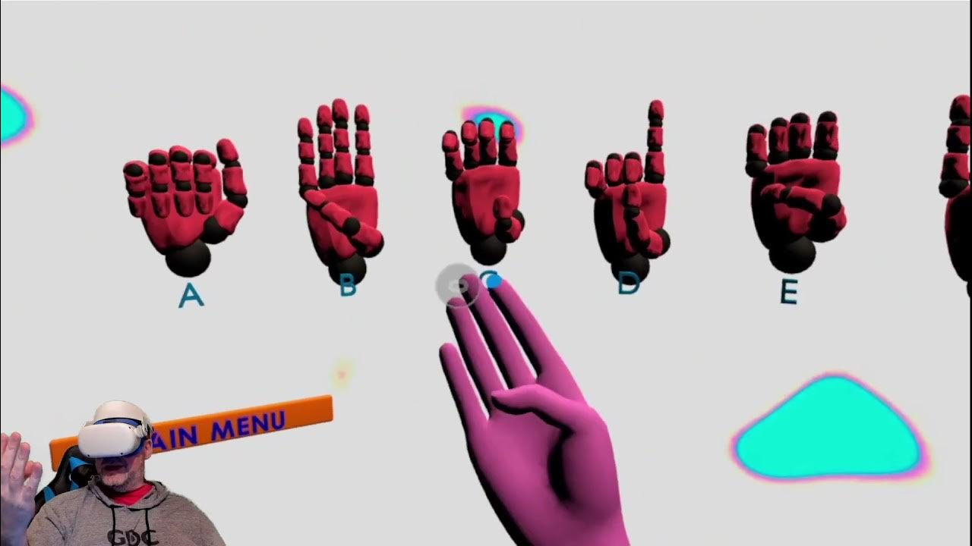
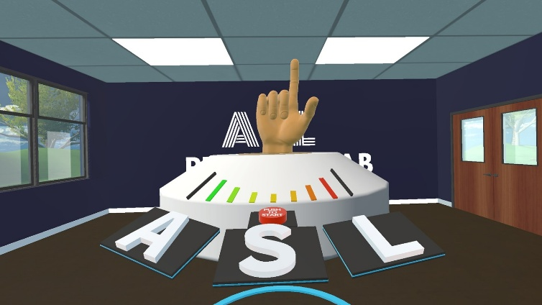
Background
Existing VR tools like ASL Fingerspeller and Silent Classroom VR show that immersive environments improve engagement, but focus mainly on American Sign Language
Research (e.g. Novaliendry et al.) shows VR with real-time feedback increases learner confidence and effectiveness
Applications like ASL Champ! demonstrate the importance of immediate feedback for skill improvement
Ethical Approach: Designed with Deaf community input, respects ISL cultural significance & accuracy (vs avatars as substitute)

Slide 5
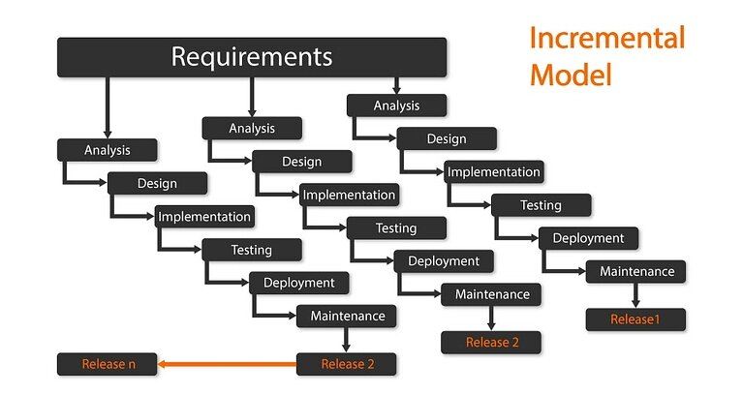
Methodology
Incremental Model

Slide 6
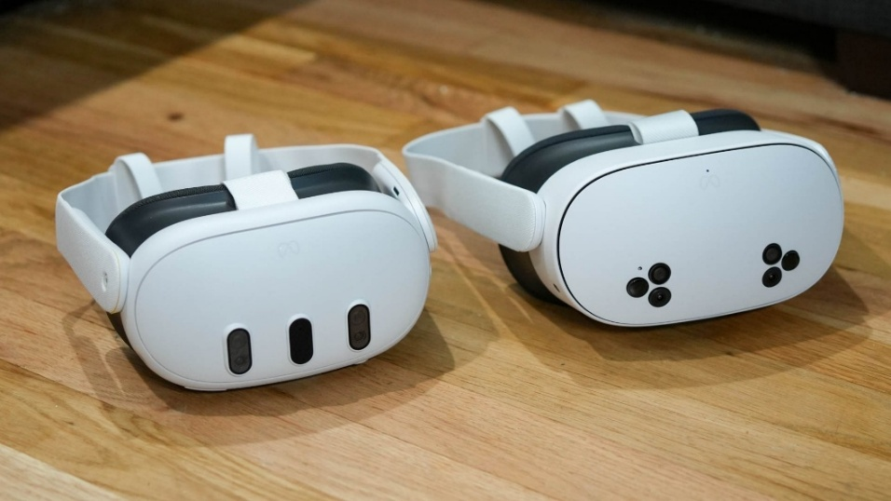

Technologies
Operating Systems(s): Meta Quest 3/3S (VR headset OS)
Programming Language(s): GDScript
XR Framework: OpenXR
Game Engine: Godot 4

Slide 7
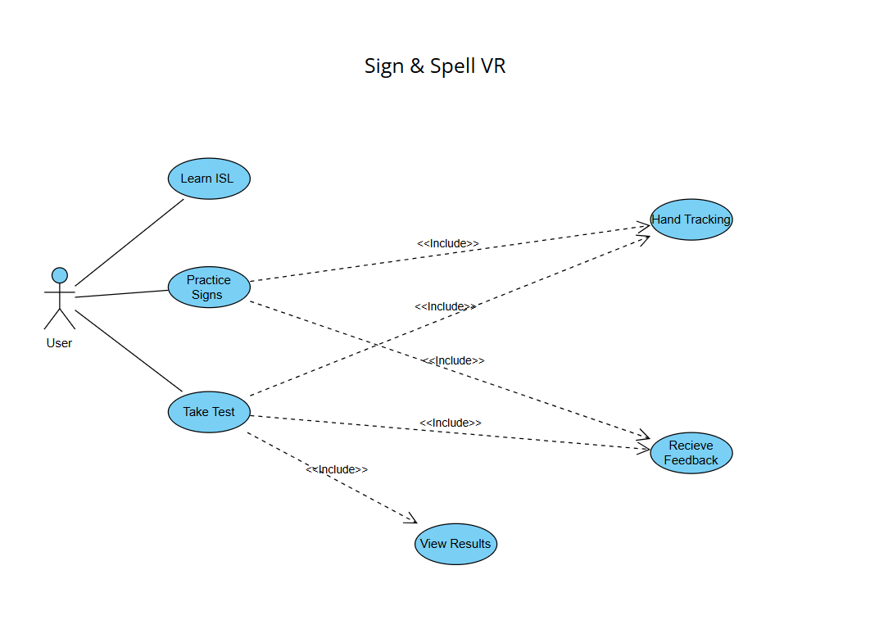
System Requirements
Requirements
Stakeholder Interviews: Learners, Deaf Community, Teachers
Functional
Hand Tracking, Sign Recognition, Feedback
Non-Functional
Low Latency, accessible UI, intuitive design

Slide 8
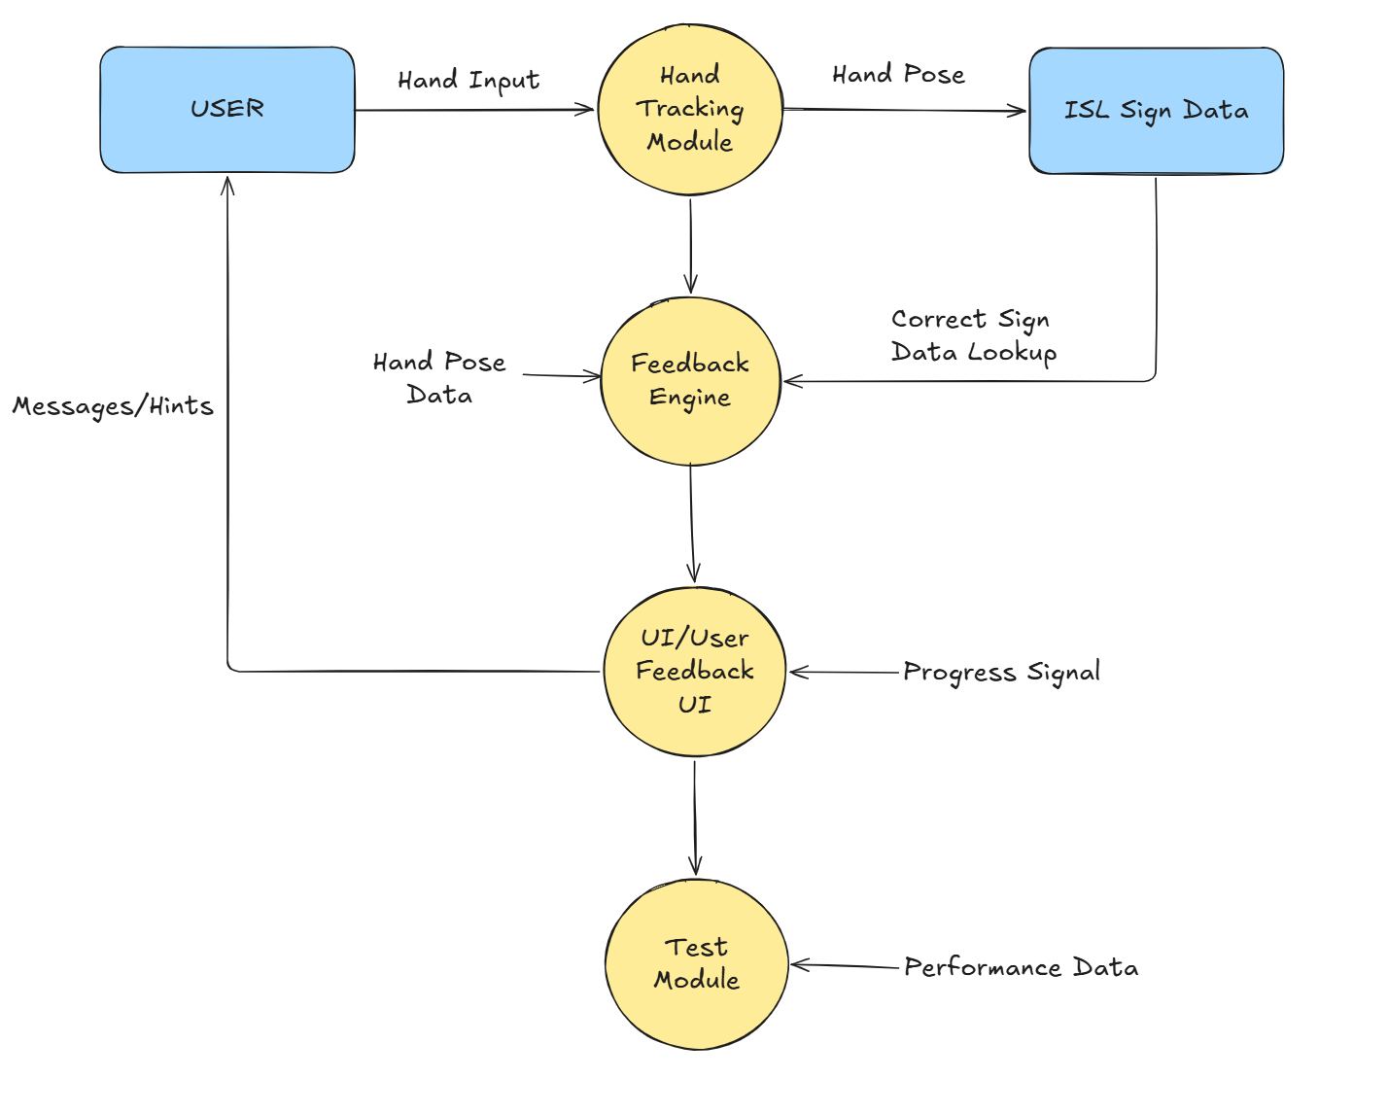
Technical Architecture
Standalone VR application on Meta Quest 3/3S
Hand tracking → Recognition → Feedback → Test
Data Flow Diagram

Slide 9
Front End Design
Main – Learning Scene
User enters VR → sees main menu
Selects Learn Mode using hand gestures
System shows letter + model + instructions
User copies the sign → gets live feedback (❌ / ⚠️ / ✅)
Holds correct sign → progresses to next letter
Completes letter → thumbs up gesture to return to menu
Test Scene
Prompts a letter to sign
Holds the letter
At the end, checks the score and see what is wrong
Optional:
Use case or prototype screens
Optional:
Use case or prototype screens
Optional:
Use case or prototype screens

Slide 10
Middle Tier Design
Hand Pose Detection: OpenXR sensors detect finger positions in real-time
Gesture Matching: Compare user hand pose to stored ISL sign database
Confidence Validation: Check if pose matches threshold for correct/incorrect
Real-time Feedback: Generate visual feedback (correct/try again) instantly
Rule-based recognition: simpler, faster setup

Slide 11
DEMO HERE
DEMO HERE
Small parts of system

Slide 12
Evaluation Criteria
<Suggest how you will know whether or not your development was a success>
<Testing is part of this, but is there anything else?>

Slide 13
Future Work
Implement all the letters
Find a way to implement motion
Implement phrases and sentence structures
Improve confidence checks for feedback
Get companies to help out in improving the project

Slide 14
Thank you!
?
Questions
?

